Slide 1

Online Shopping System
Guided By:- Dr. Shashank Bhardwaj
Presented by:-
Gargi Agarwal (2000290140046)
Pinkush Gupta (2000290140084)
Shristi Jain (2000290140117)
Soyab Khan (2000290140124)

Slide 2
Overview:
TECHNOLOGY USED
FEASIBILITY
INTRODUCTION REQUIREMENTS
DESIGN
FUTURE SCOPE
GANTT CHART
CONCLUSION

Slide 3
Introduction:
The Online Shopping System (OSS) for clothing item shop web application is intended to provide complete solutions for vendors as well as customers through a single get way using the internet. It will enable vendors to setup online shops, customer to browse through the shop and purchase them online without having to visit the shop physically. The administration module will enable a system administrator to approve and reject requests for new shops and maintain various lists of shop category.

Slide 4
Functional Requirements:
This section provides requirement overview of the system. Various functional modules that can be implemented by the system will be –
Registration
Login
Changes to Cart
Payment
Logout
Report Generation

Slide 5
Non-functional Requirements:
Secure
Reliability
Maintainability
Portability
Extensibility
24*7 Availability

Slide 6
Hardware Requirements:
Processor: Dual Core
RAM: 2GB
HARD DISK: 320GB

Slide 7
Technology Used:
For Frontend:
HTML/CSS-Bootstrap
For Backend:
PHP
Database:
MySQL

Slide 8



Feasibility:
Technical Feasibility
:
Financial Feasibility :
Operational Feasibility :
Technically, this project is very feasible because of use of current and latest techniques.
Financially, It is also very feasible it made up in very low cost and will be free for all
customers.
Very easy to use.

Slide 9
Design:
Determining and finalizing graphical theme of websiteand web applications
Layout and structural design
Creating all graphical elements

Slide 10
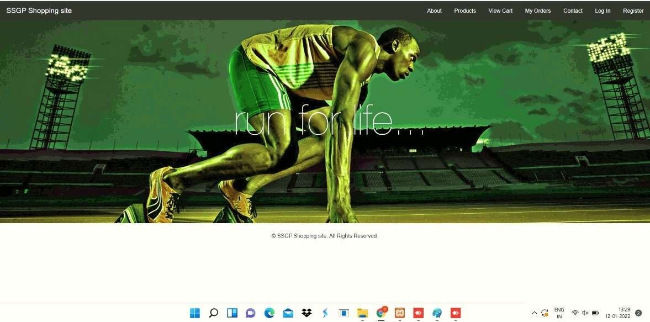
Home Page

Slide 11
Future Scope :
Increase In Direct Sales From Manufacturing Brands To Consumers.
The Rise of Small, Local and Private Label Brands.
Data-Driven Marketing and Analytics-Based Strategy.
This system allows the customers to maintain their cart for add or remove the product over the internet.

Slide 12
Conclusion :
Technology has made significant progress over the years to provide consumers a better online shopping experience and will continue to do so for years to come. With the rapid growth of products and brands, people have speculated that online shopping will overtake in-store shopping

Slide 13


